Slide 1




HOPE TO SKILL
Lecture 35
Transformer
Artificial Intelligence Advance Course

Slide 2


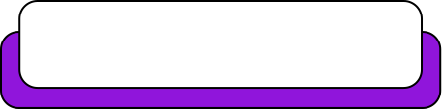
Dedicated to my late Teacher, a beacon of Knowledge.
Your Guidance shaped me; now I shape others through
a free course.
YOUR LEGACY LIVES ON!

Slide 3





AI INSTRUCTORS
Dr.Irfan Malik
Dr.Sheraz Naseer
Dr.Shazia Saqib
Ramsha Imran
M.Haris Tariq

Slide 4



Previous Lecture Topics
01
Concept of Attention
02
How Attention works
03
RNN & LSTM Practice

Slide 5
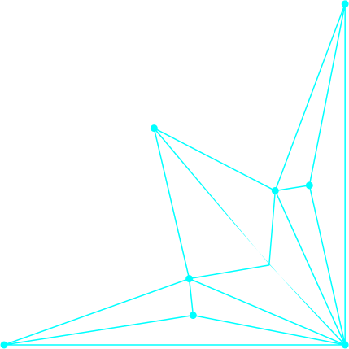
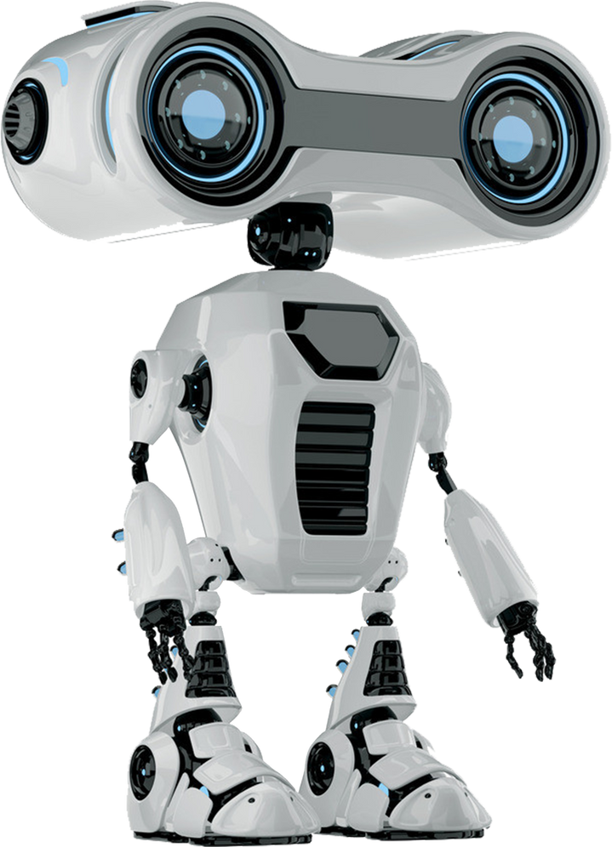
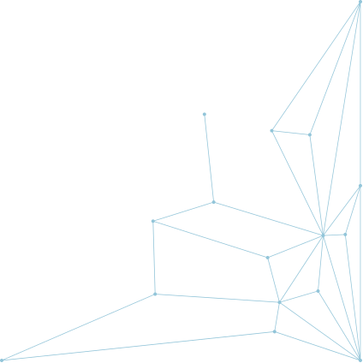
Outline
Transformer Models
Transformer Architecture
Encoder
Decoder
BERT
GPT

Slide 6

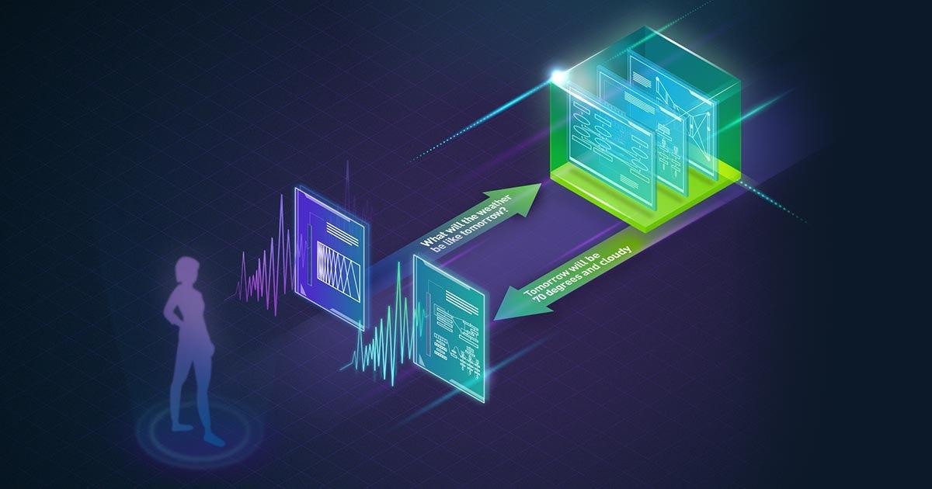

What are Transformers?
A transformer is a Generative model that learns to understand and generate human-like text by analyzing patterns in large amounts of text data.

Slide 7
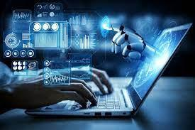
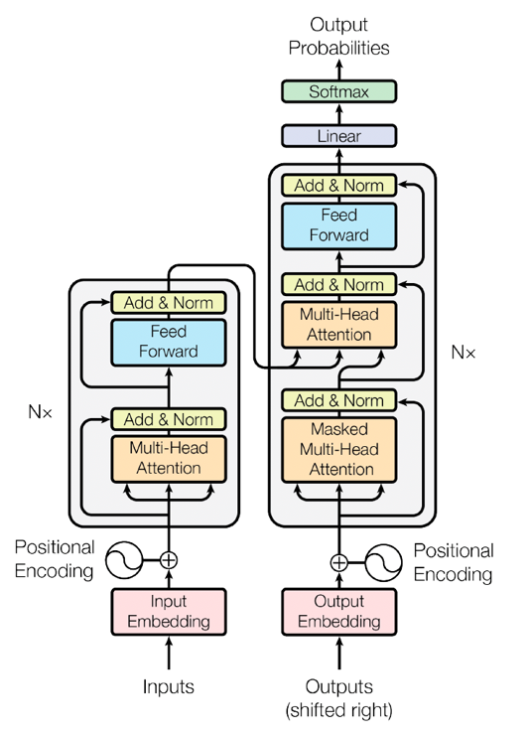
What are Transformers?
Transformers were developed to solve sequence transduction or neural machine translation tasks.
They transform an input sequence to an output sequence. This is why they are called “Transformers”.

Slide 8

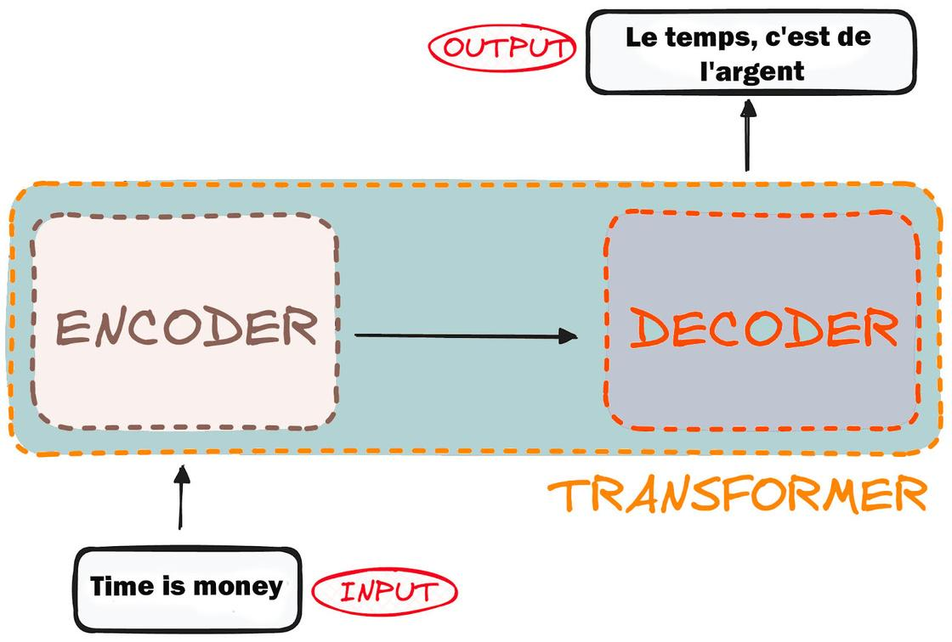
Transformer Architecture
Encoder and Decoder
The encoder takes in our input and outputs
a matrix representation of that input. For
instance, the English sentence
“Time is Money”
The decoder takes in that encoded representation and iteratively generates an output. In our example, the translated
sentence “Le temps, c'est de l'argent.”

Slide 9
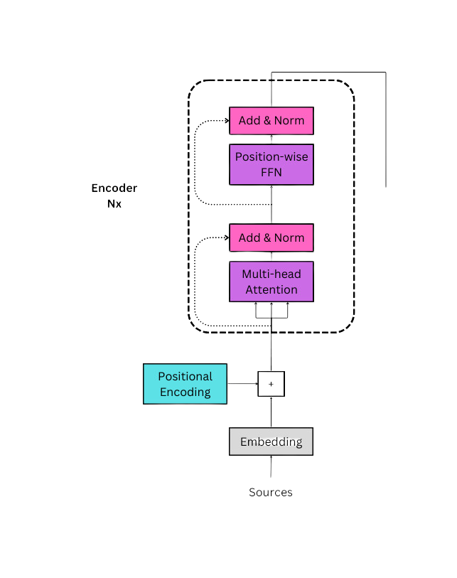
Encoder

Slide 10
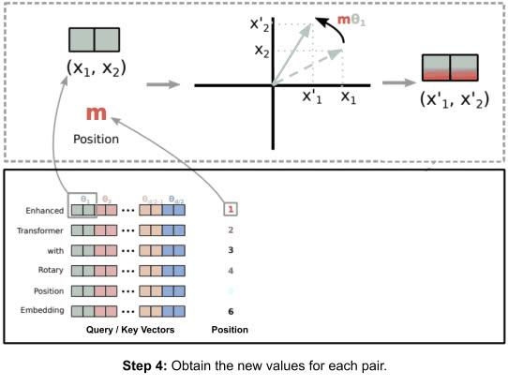
Positional Encoding
Positional encoding is a critical component in transformer models, allowing them to handle sequential data by encoding the positions of tokens in a sequence.
This enables transformers to capture the order and structure of the input data.

Slide 11
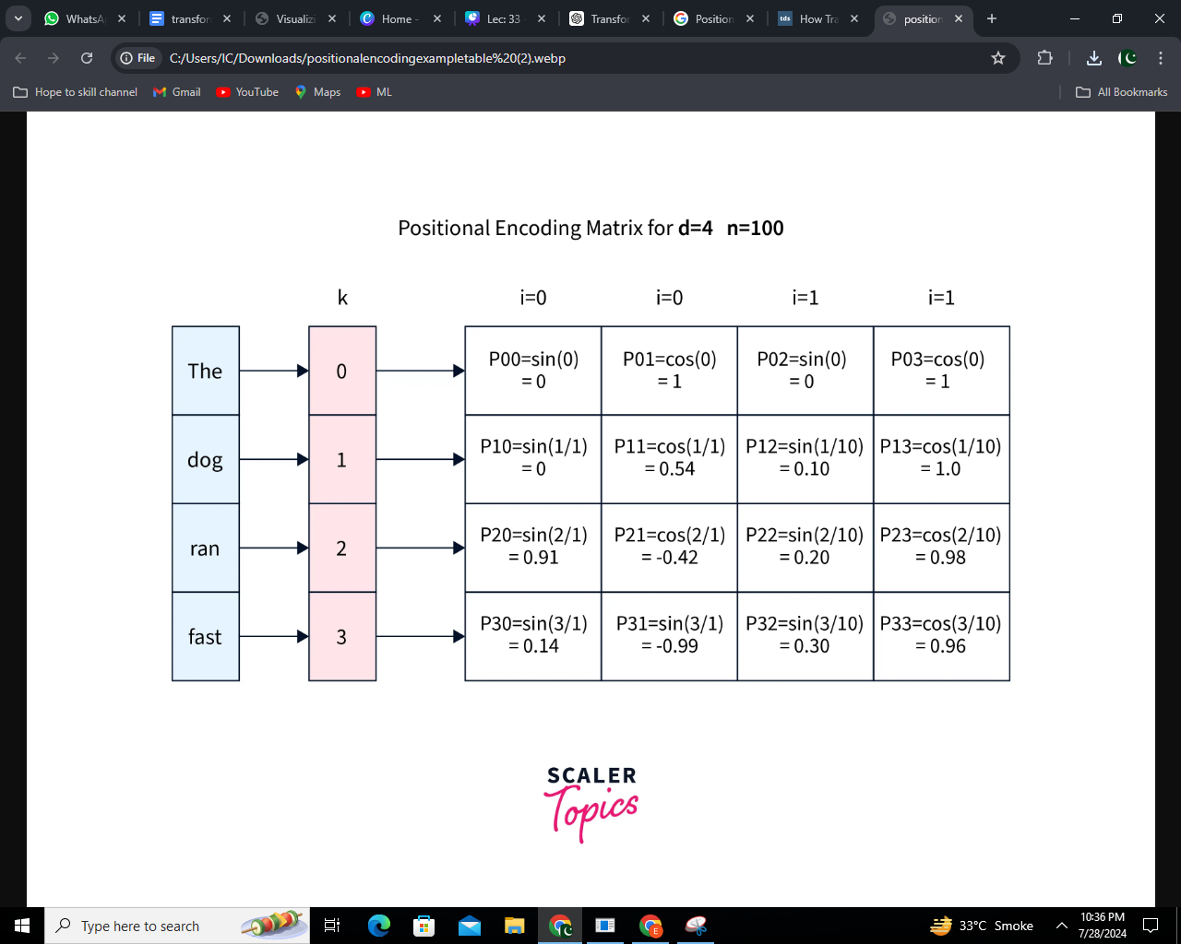
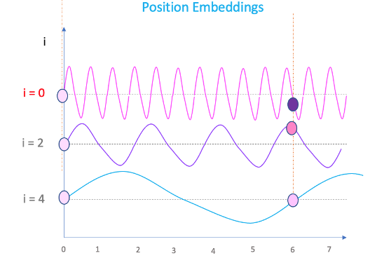
Positional Encoding
Positional encoding provides
information about the position
of tokens in a sequence for
transformer models, which
process tokens in parallel.

Slide 12
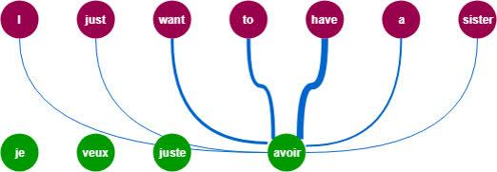
Self Attention
Self-Attention: Focusing on different
parts of the same sentence.
Transformers: Powerful tools using
self-attention.
Key Idea: Processes whole sentences
at once, like reading a full page
instead of line by line.

Slide 13
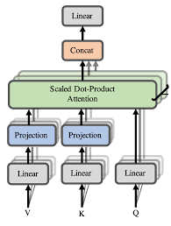
Multihead attention
Multi-head attention extends self-attention by splitting the input into multiple parts (heads) and processing them independently.
Each head computes its own attention scores, capturing diverse features and patterns.

Slide 14
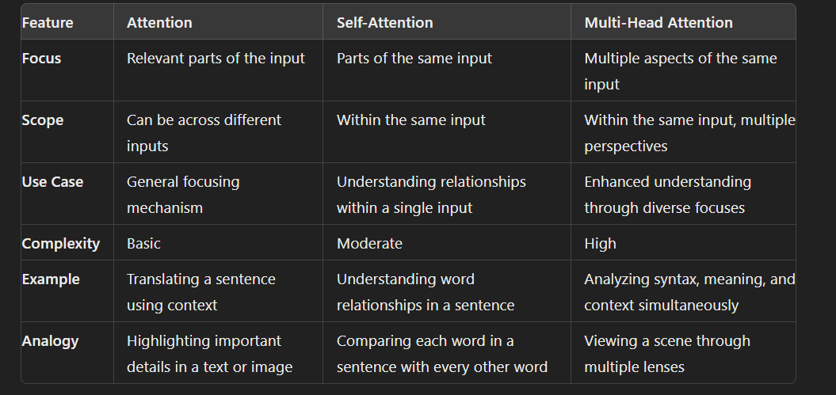
Summarized Comparison

Slide 15
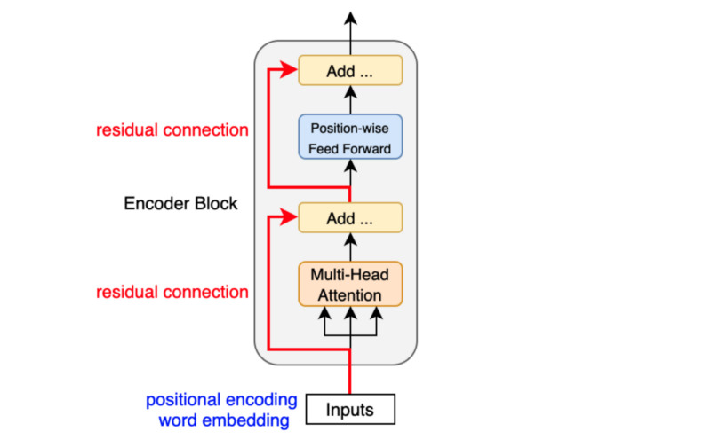
Encoder Block
Encoder:
It takes input source language
Add positional encoding
Pass to Muti-head Attention
Then normalize the layer
Pass to Feed Forward Network
Output embedding

Slide 16
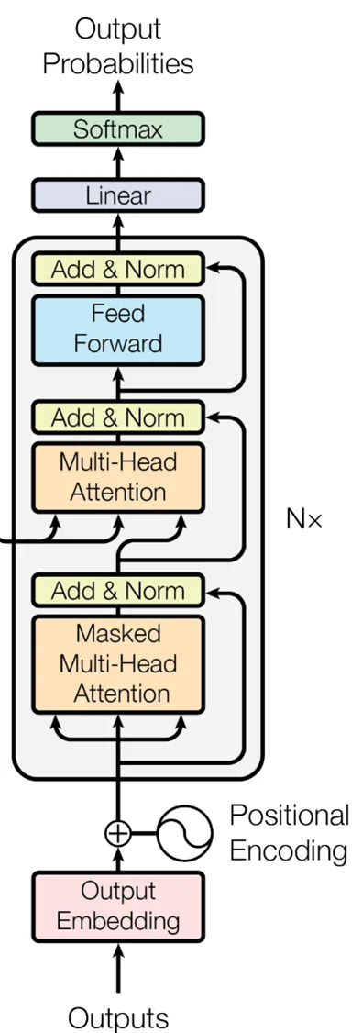
Decoder

Slide 17
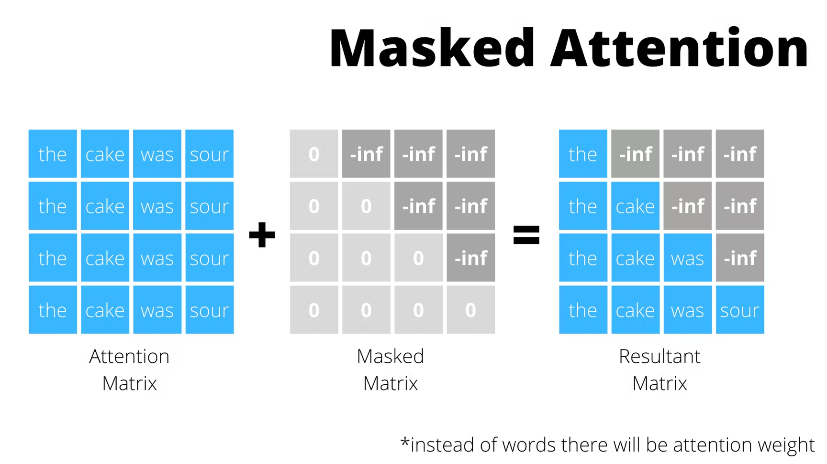
Masking

Slide 18
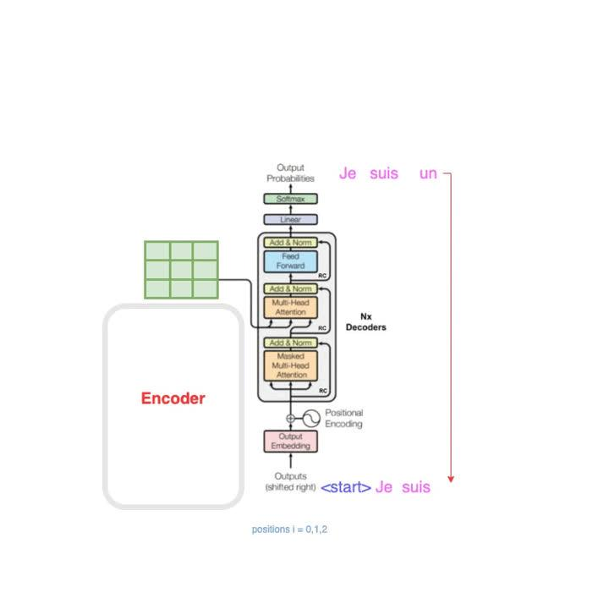
Decoder Block
Decoder:
It takes input target language
Hide some word (mask)
Add positional encoding
Pass to Masked Multi-head Attention

Slide 19
Decoder Block
Decoder:
Pass the output embedding of encoder and Masked Multi-head Attention to Multi-head Attention
Feed Forward Network
Linear projection (make it 1D)
output class value

Slide 20
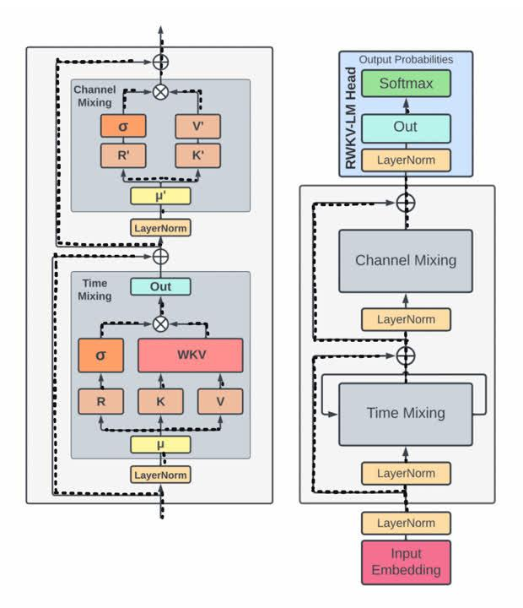
The Transformer Model
Components: Boxes for Encoder, Decoder,
Attention layers.
Key Features: Fast and good at
understanding long texts.

Slide 21
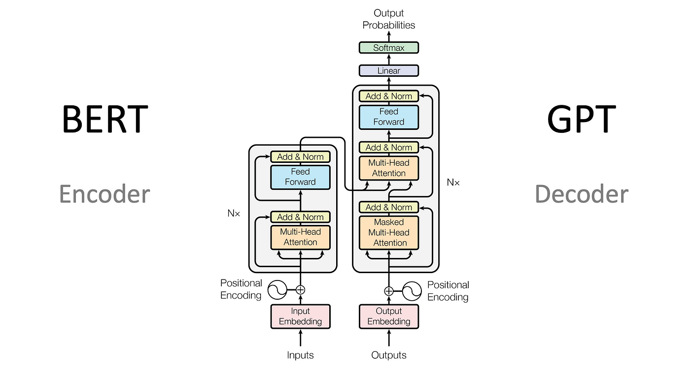
BERT and GPT

Slide 22
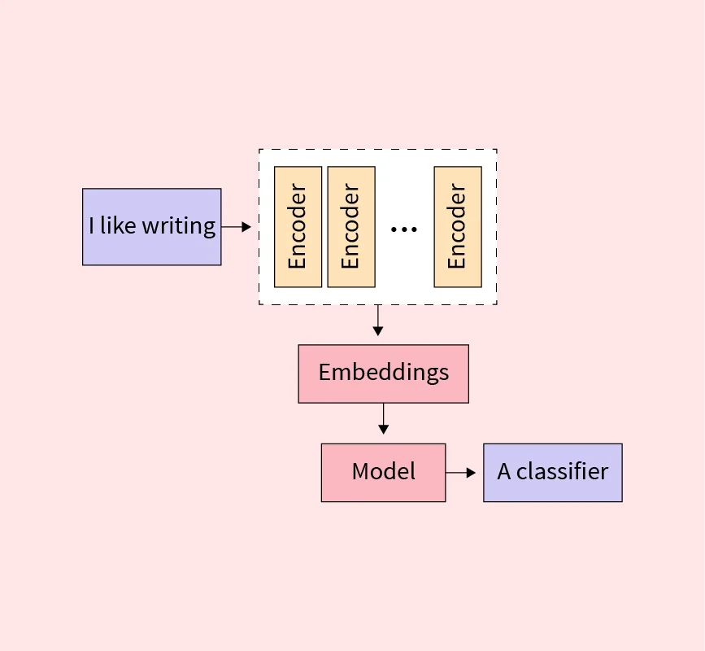
How BERT Works
Overview:
BERT (Bidirectional Encoder Representations from Transformers): A groundbreaking NLP model developed by Google that leverages the Transformer architecture.

Slide 23
How BERT Works
Bidirectional Contextualization:
Unlike traditional models, BERT reads text in both directions (left-to-right and right-to-left) simultaneously, capturing deeper context.

Slide 24
How BERT Works
Transformers:
Utilizes self-attention mechanisms within Transformers to weigh the importance of each word in a sentence relative to others, enabling nuanced understanding.

Slide 25
How BERT Works
Pre-training & Fine-tuning:
Pre-trained on vast corpora with tasks like Masked Language Modeling (MLM) and Next Sentence Prediction (NSP).
Fine-tuned on specific tasks (e.g., Q&A, sentiment analysis) by adding task-specific layers.

Slide 26
How BERT Works
Output:
Embeddings

Slide 27

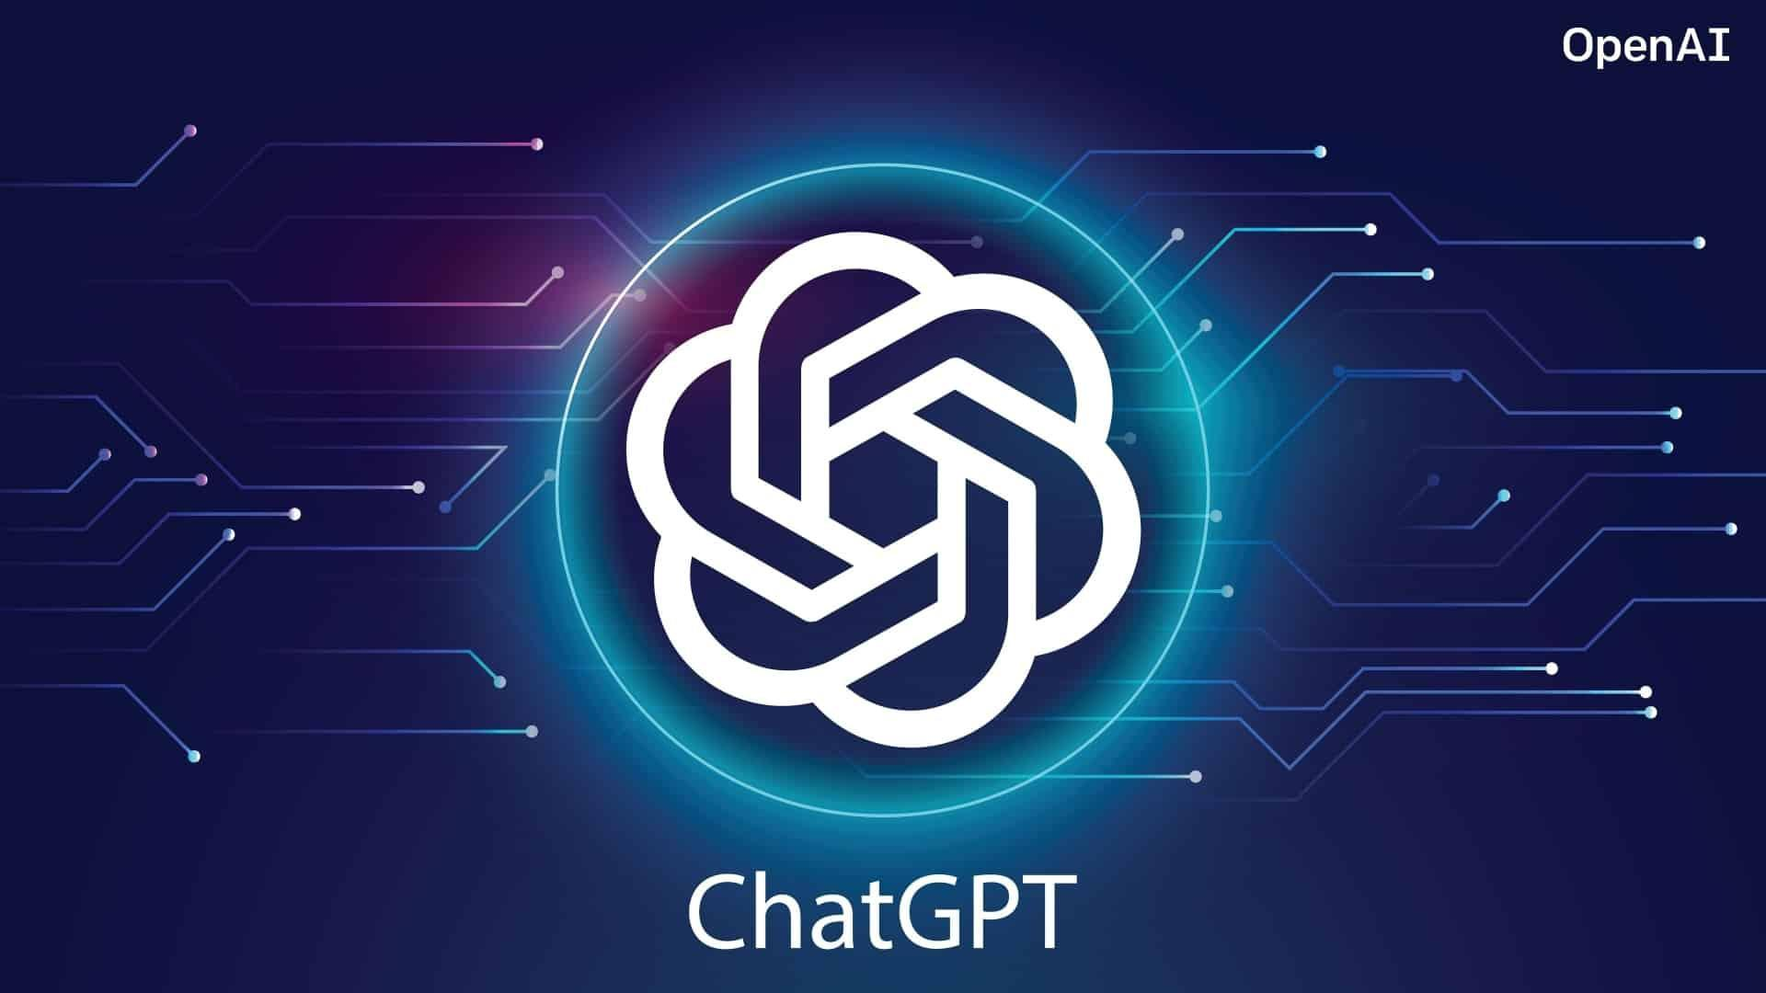
Introduction to GPT
What is GPT?
Definition: Generative Pre-trained
Transformer.
Explanation: A smart computer
program that writes text.
Applications: Writing stories,
chatbots, language translation.

Slide 28
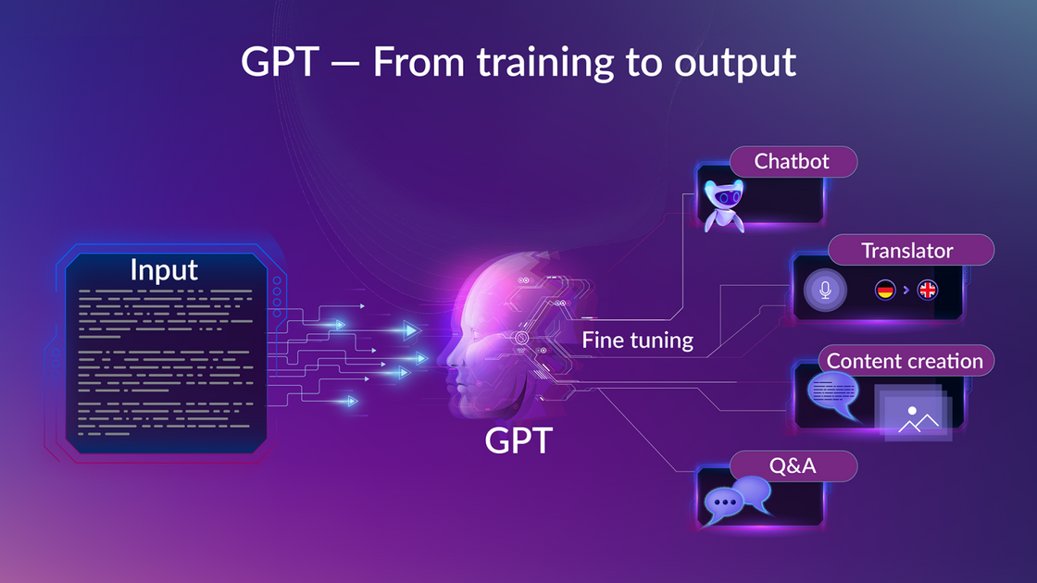
How GPT Works
Overview:
GPT (Generative Pre-trained Transformer): An advanced NLP model by OpenAI designed for
generating human-like text based
on input prompts.

Slide 29
How GPT Works
Autoregressive Language Model:
GPT generates text one word at a time, predicting the next word based on previous ones, enabling coherent and contextually relevant text generation.

Slide 30
How GPT Works
Transformers:
Employs a unidirectional Transformer
architecture where each token is processed sequentially, leveraging self-attention mechanisms to understand context.

Slide 31
How GPT Works
Pre-training & Fine-tuning:
Pre-trained on diverse and massive datasets through the task of predicting the next word (Language Modeling).
Fine-tuned on specific tasks or domains to enhance performance on applications like chatbots, content generation, and code completion.

Slide 32
How GPT Works
Output
Content Generation, Responses to Questions, Text Summarization , Code Completion etc

Slide 33
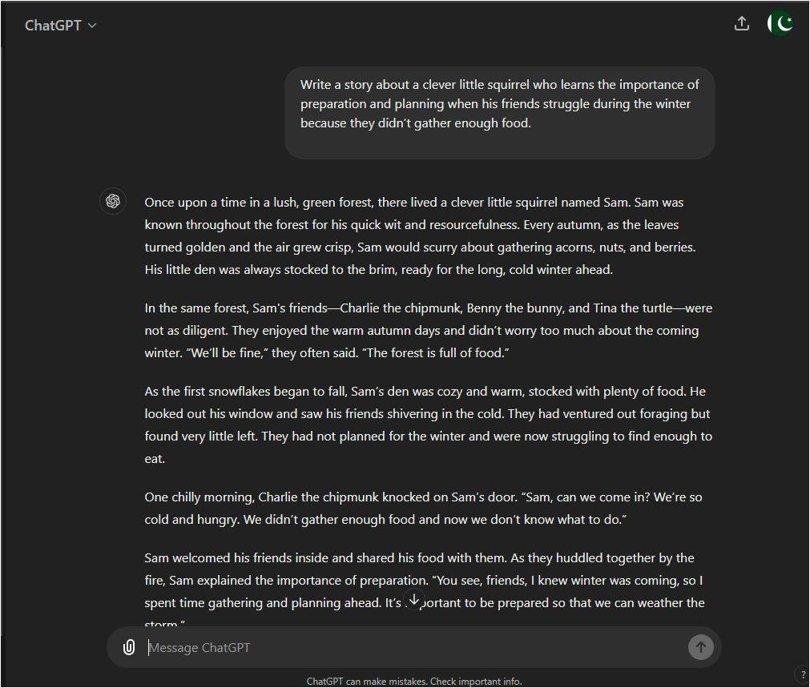
GPT in Action
Explanation: How it uses what it learned to make sense of new text
Example: How GPT writes a short story or answers questions.

Slide 34

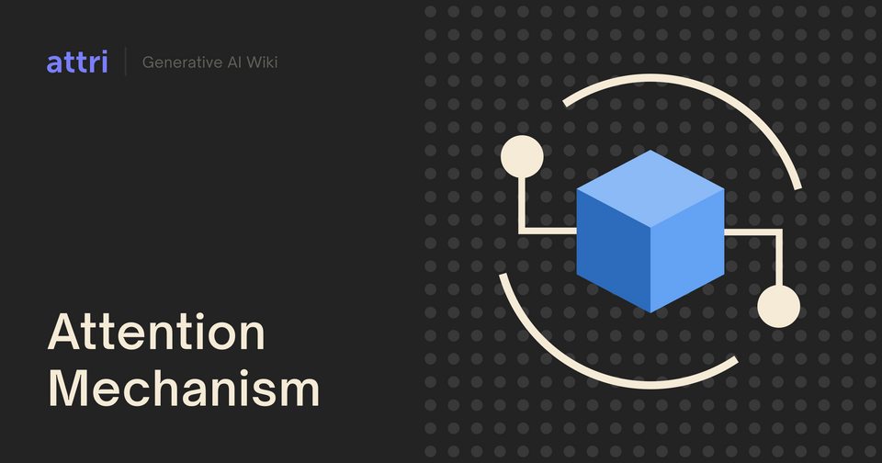

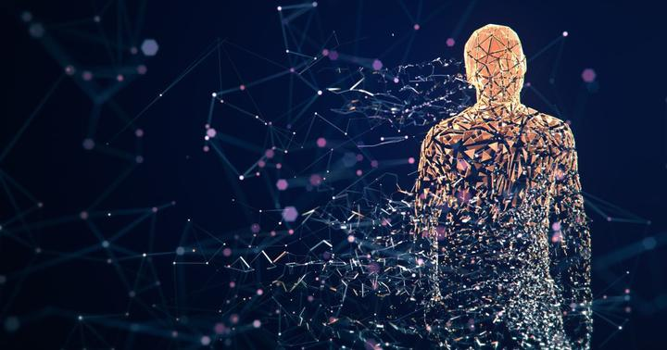
Benefits of Attention and GPT
Why Use Attention and GPT?
Better Memory:
Remembers important
details in long texts.
Speed:
Works quickly by
processing many parts
at once.
Versatility:
Can do many different
tasks like writing, translating,
and chatting.

